Slide 1
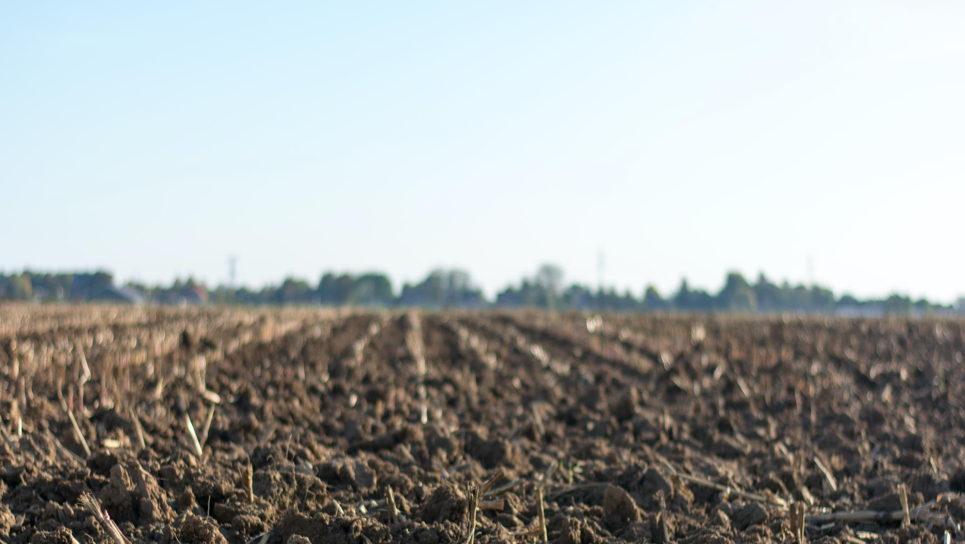

ONSITE COMPOSTING CAN REDUCE THE MANURE WORKLOAD
tim@dungstercomposting.com
www.dungstercomposting.com

Slide 2
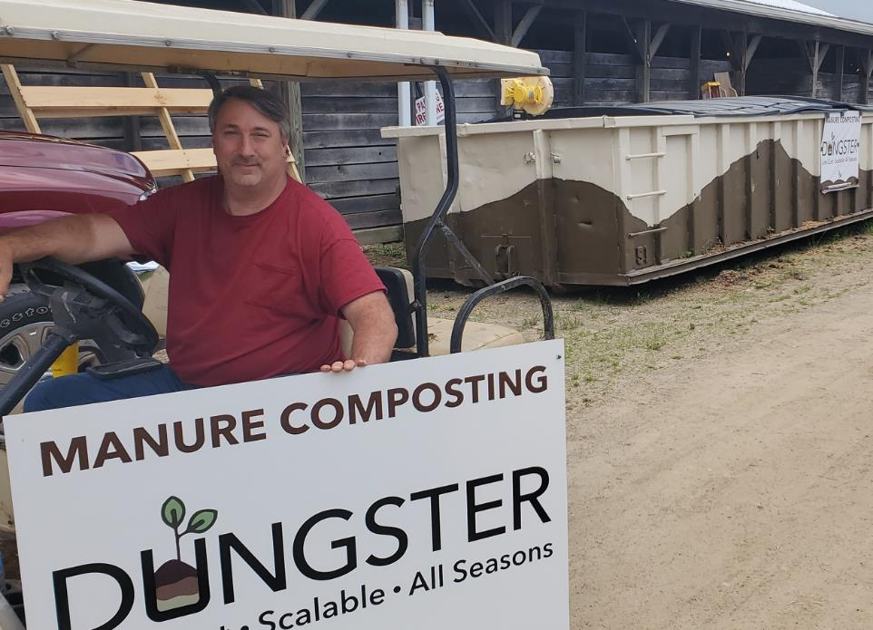

Vince and Pam challenged me
to create a manual loading method.
WPQHA,
Safety buff,
manual loading
only
Small farmette,
no tractor
on the property
Bonus:
Economy of Effort

Slide 3


Bonus: Economy of Effort …
Who has spare time?
Where are the laborers?
Why do we make more work?
While not making compost!
dungstercomposting.com

Slide 4
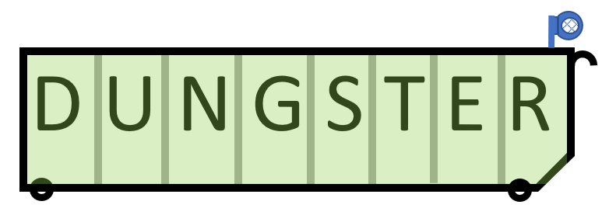
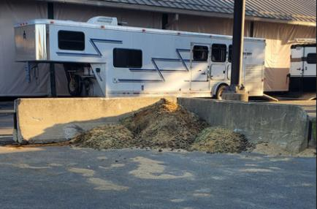
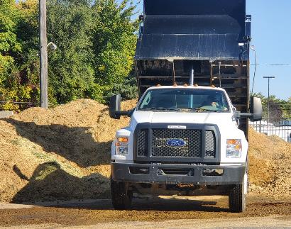
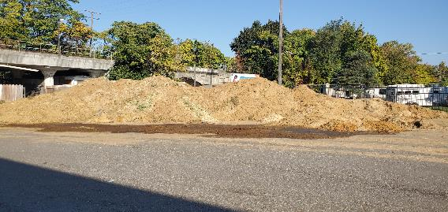
Today’s Usual Movements
(at this fairground)
On-site Composting.
Let us look at this step
after the next slide.
Stall
Out-the-door
Piles
Consolidated
on-site
Pile
Off-site
Pile
Composting or
Spreading or
Disposal
Equipment: Wheelbarrow
Cap. Cost: $100.00
Off-site Outcomes:
Positive (cash?)
Positive/negative
Negative
Equipment: Tractor or equal
Cap. Cost: $10,000.00
Equipment: Tractor or equal
Cap. Cost: $10,000.00
Equipment: OTR Dump Truck
Cap. Cost: $100,000.00
dungstercomposting.com

Slide 5
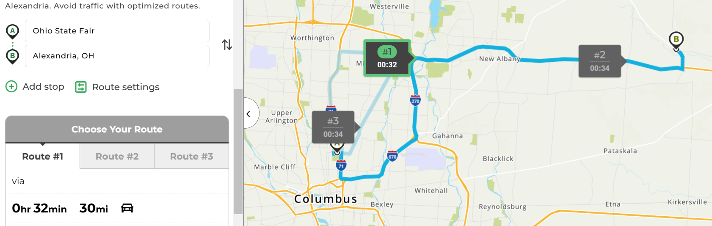
Disposal of QH Congress Manure (3rd step)
This is: ~ 60 miles depreciation on a large diesel OTR dump tractor/trailer x $1.35=$81.00
~ 10 to 12 gallons of diesel fuel consumed $48.00
~ CDL driver’s on-the-clock time $100.00
$229.00/Trip
$1,832/day
Has there been any value added?
Do we have a waste or a product?
Who owns the valued product?

Slide 6
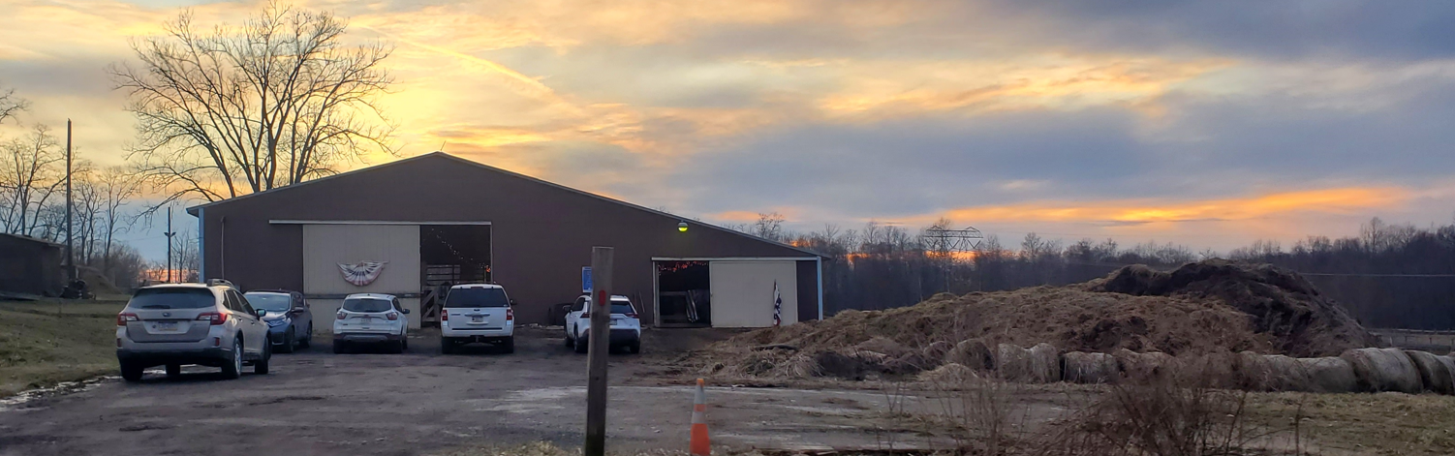
A horse boarder in Pennsylvania
Multiple piles “out-the-door” and consolidated
An “out-the-door” pile
Consolidated Pile

Slide 7
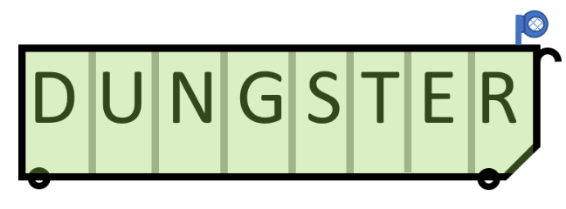
Stall
Composter #2
Composter #1
On-site Composting following
“Economy of Effort” and the
“O.H.I.O Principle”
Only
Handle
It
Once
Composting
Daily Filling
Flip-
Flop
Roles
With two vessels available, one is absorbing daily chores
the other one is running as a composter, converting manure into compost
dungstercomposting.com

Slide 8


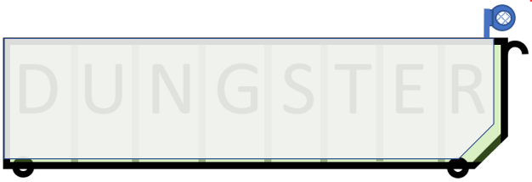
On-site Composting following
“Economy of Effort” using the
“O.H.I.O Principle”…
Only
Handle
It
Once
Ramp installation:
1st Support and ramp
2nd Support and ramp
3rd Support and ramp
Inside view
Outside view
Manure and soiled bedding is only touched once!
Manure and soiled bedding is never placed on the ground!
dungstercomposting.com

Slide 9
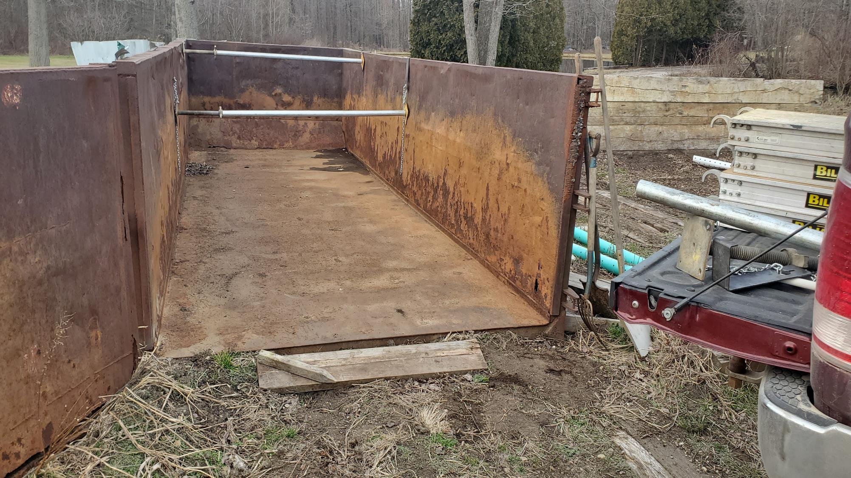
Add horizonal support rails

Slide 10
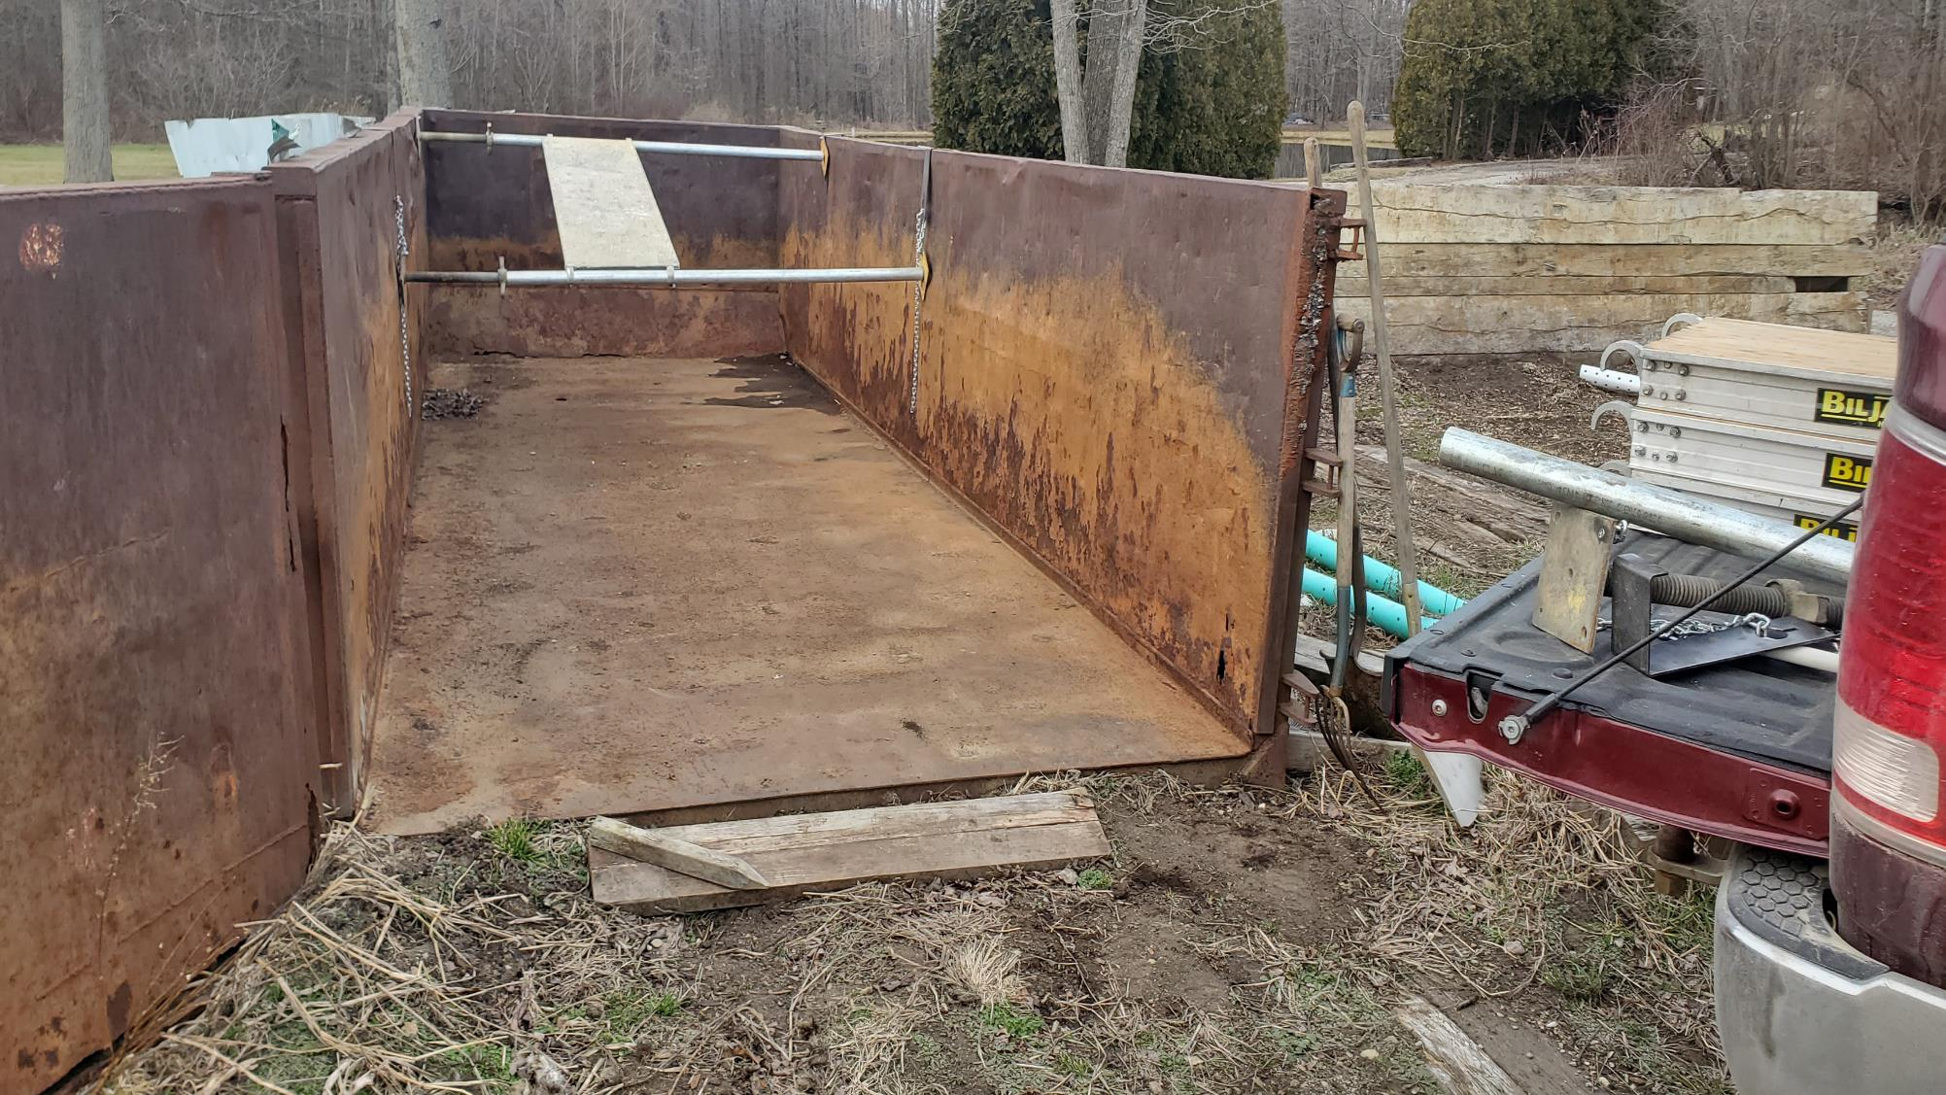
Add horizonal support rails
Add inclined ramps

Slide 11
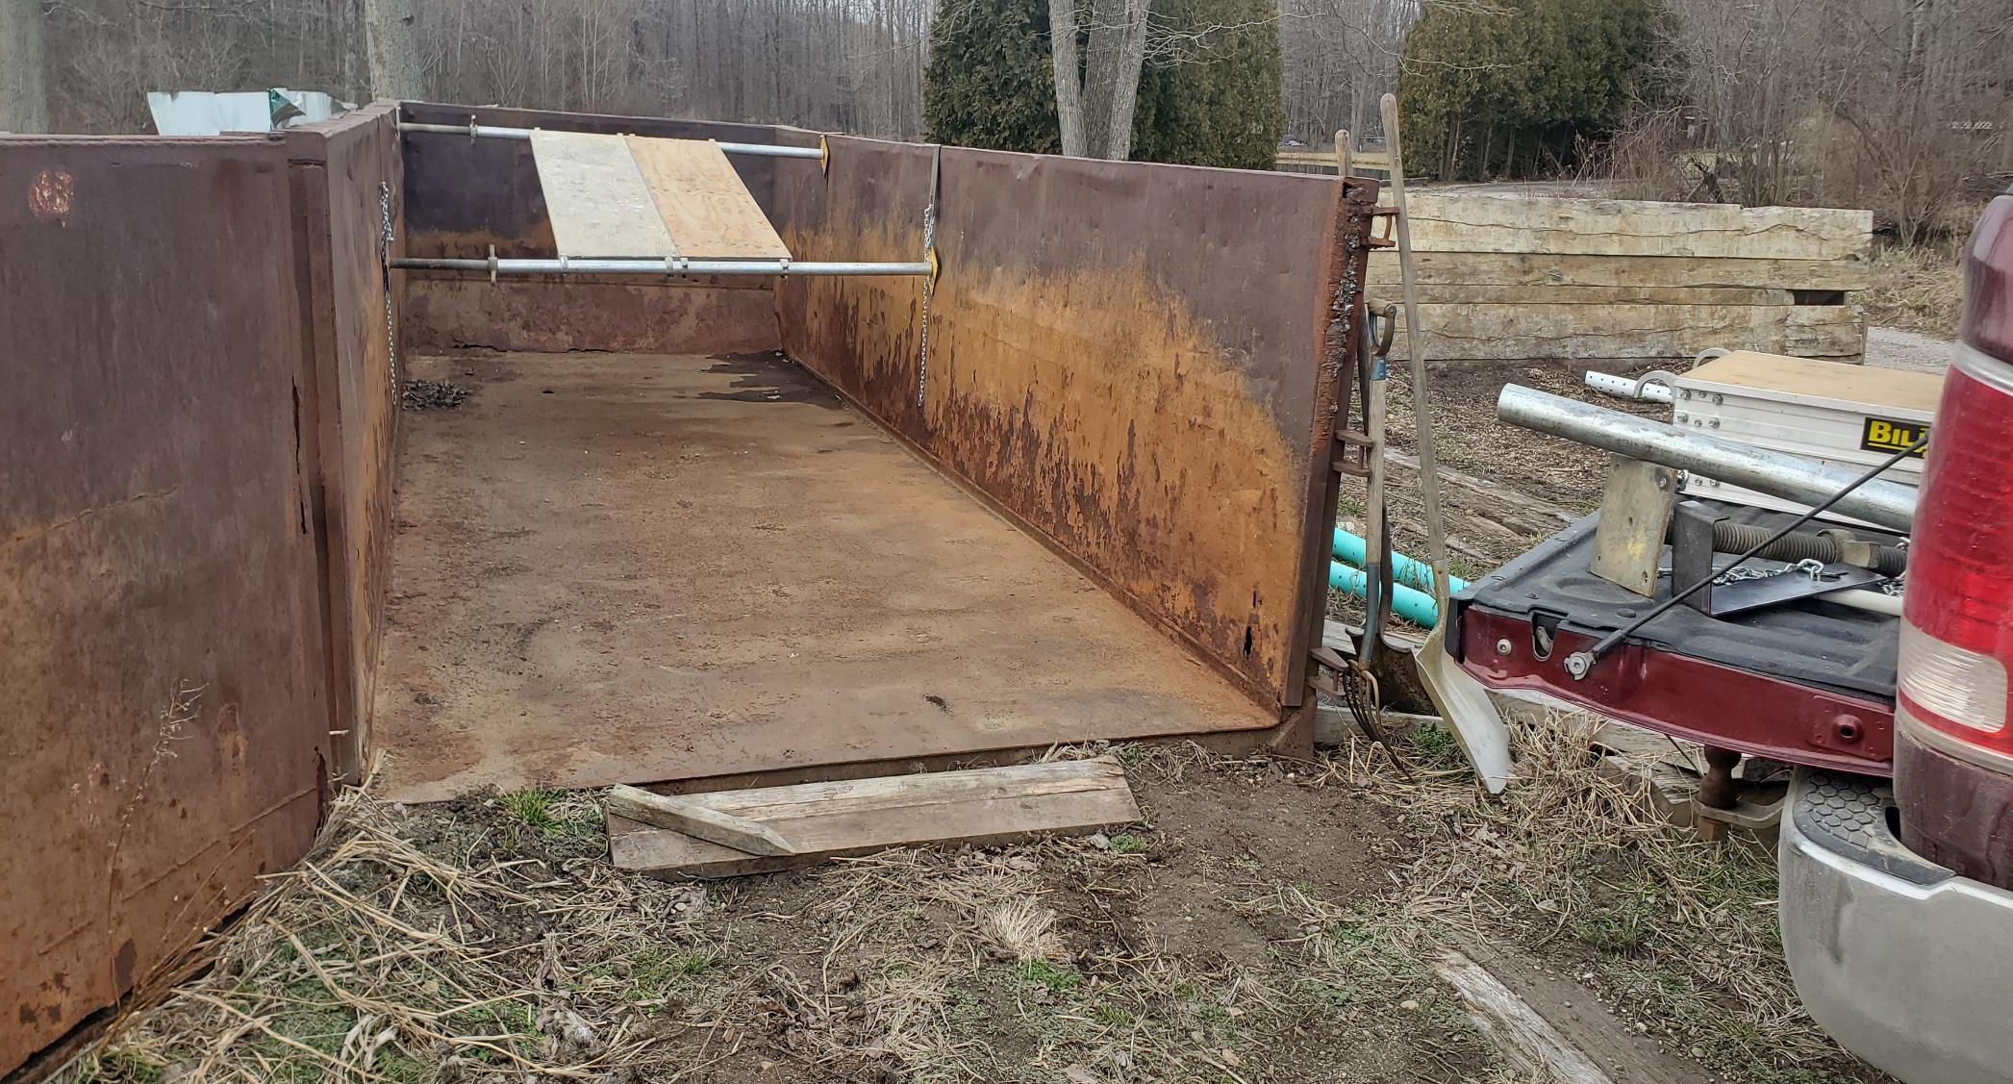
Add horizonal support rails
Add more inclined ramps

Slide 12
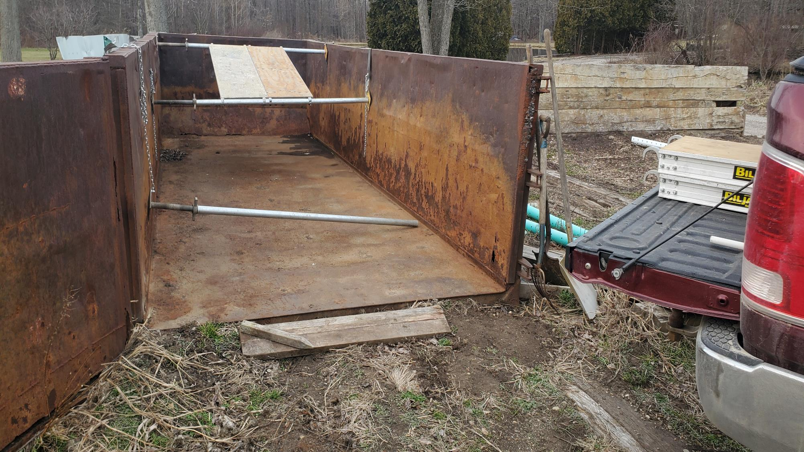
Another horizonal support rail

Slide 13
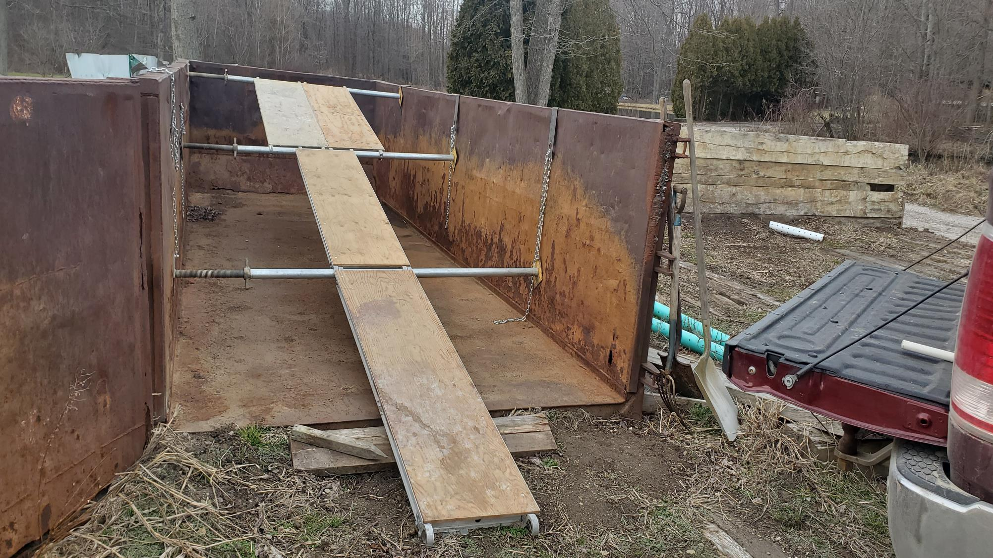
Additional inclined planks
and you are done!

Slide 14
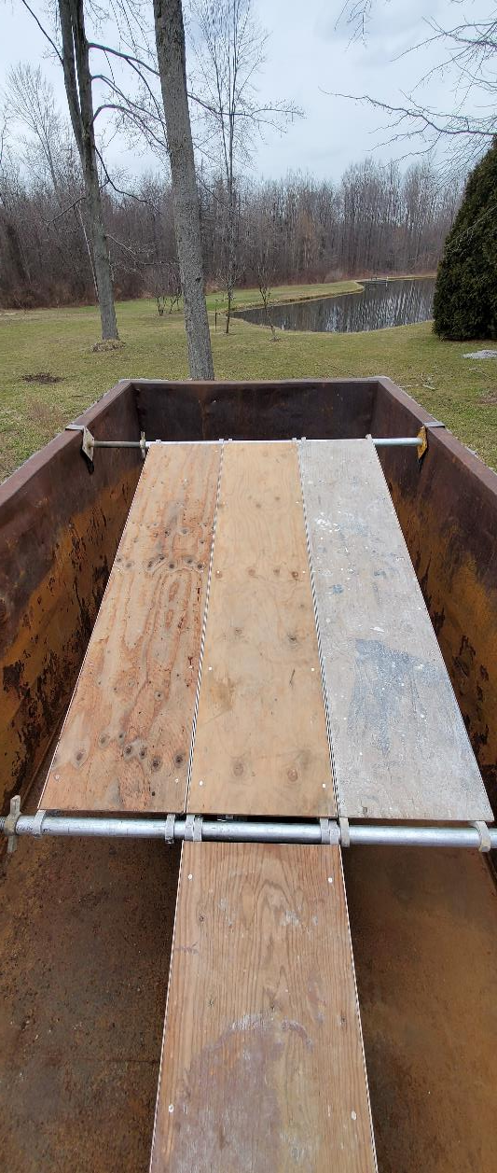
Engineered for…
Gentle 12-degree up-slope
No permanent modifications
10-minute installation
No tools required
Below the OSHA height limit
Rock solid under foot!
Select 1 of 3 widths
Adjust location as filling
One-man operation
Using proven components
Using cost effective goods
Flexible Ramps
57 inches wide
Max-Walk
38 inches wide
Fat-Walk (for
2-wheel carts).
19 inches wide
Cat-Walk (only for
Wheelbarrows).
1,000 LBS Capacity!

Slide 15
Keeping the“O.H.I.O Principle”…
Ramps are shifted toward the door as the composter is filled. No tools nor power equipment is required.
After first end is full…
Adjusted ramp installation:
1st Support and ramp
2nd Support and ramp
3rd Support and ramp
Top ramp is next shifted toward the “D” in Dungster
Next time material is handled (unloading) it is compost!
dungstercomposting.com

Slide 16
ROI: 30 yards a month input = 20 yards of compost output (volume is reduced 1/3rd).
20 yards compost x $40/yard = $800/month income or $9,600/year income
dungstercomposting.com

Slide 17

Investment Summary
Stall
Composter #2
Composter #1
Equipment: Ramp System
Capital Cost: $1,500.00
Flip-
Flop
Roles
Composting Equipment: dumpsters (2), blower & control (1), aeration systems (2)
and ramp system (1) (wheelbarrow not included)
Capital Cost: New ~$24,000, Used~$15,000 or Rental Cost:~$350-650/month
dungstercomposting.com

Slide 18

O.H.I.O Summary Points
“Only Handle It Once” delivers key benefits:
Economy of Effort (saves time, labor and money)
Ecology, manure is never on the ground
Promotes safety as no motorized mechanization is needed
The next time it is touched it is a “product” (compost)
not a waste, it has a positive economic value of $30-40/yard.
Value addition is owned, and credited to, the producer/owner.
dungstercomposting.com

Slide 19
Thank You!
For a copy of this presentation come add your name to this list.
dungstercomposting.com

